Slide 1
Change and the individual
Michael Oakes
rm.com/seminars

Slide 2
The process and methodology of managing individuals within an organization to facilitate a change in behaviours.
Notes:
Technical changes almost inevitably affect the way people need to behave – management of their behavior is change management
What is change management?
A process of managing individuals through change
A set of “tools” that help to ensure people adopt behaviours in line with change
A methodology based around enabling people to adopt change in a controlled manner
The side of projects that often gets overlooked
Project management = task based
Change management = behaviour based
What isn’t it?
Project management
A way to force people do what you want!
An exact science – people are unpredictable
A poor relation to project management

Slide 4
Reasons for Change Management
Benefit realization and financial outcomes
Impact and Risk Management
Resistance Management
“Business” Performance Improvement
6x improvement on keeping to schedule
9x improvement on meeting objectives

Slide 5
Planning

Slide 6
Project Description
Starling will migrate the school’s systems to a new cloud ecosystem and build a foundation for the school to take advantage of the new collaboration and information sharing tools from Google. The objective is to reduce the current server footprint and make this a foundation of tools that simplify the management and use of IT systems.
Project Deliverables
Migrate all mail to Gmail keeping the domain name the same
Migrate shared files to Team Drives with ACL set to same as school servers
Migrate user data to new G Suite user accounts
Configure Google Classroom for all users
Create Classrooms based on
Class groups
Teacher Subject Groups
Year Groups
Add Guardian access
Configure Google Sites for all school clubs
Configure Google Sites as an intranet for the school
Migrate users from Microsoft Office 2013 to using G Suite productivity apps

Slide 7
Project vs Change
Technical
Scope Management
Timescale Management
Delivery Management
Finance Management
People
Communications Management
Sponsor Management
Sponsor Coaching
Resistance Management
Notes:
Project vs Change Management

Slide 8
What is changing…
What if we don’t…
Why are we changing…
What’s in it for me…
Notes:
The Brief

Slide 9
(Change) Project Description
Project Starling will change the way we communicate, from the tools we use to the way we work, it will revolutionize the way in which we share and store information across the school.
If we don’t change our process now we will
not be able to afford the upkeep of the current IT.
become less attractive to potential students as we get further behind with IT.
risk being non-compliant with the data protection through ageing IT.
These changes will reduce the cost incurred for the school for keeping and licensing large hardware reliant systems. Leaving finances to be allocated to projects closer to the classroom.
The project will create a simple platform to reduce the amount of time spent sharing, searching for and curating information. Giving time back to users for their primary roles.
It will involve new working practices that will ensure communications have clear channels, are faster and collaborative. Ensuring clarity and simplicity for all users.

Slide 10
Primary Sponsor
Project Manager
Objectives
Budget
ROI
Change Manager
Core Project Team
Notes:
The Core Team

Slide 11
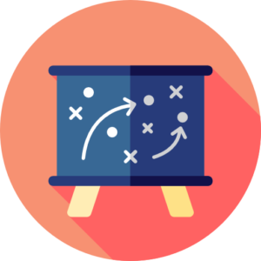
Primary Sponsor
Project
Change
Notes:
The Primary Sponsor – tell them what their role is

Slide 12
Confidence Capacity Receptiveness
Primary Sponsor
Project Manager
Assistant Head
PE
Science
Change Manager
Team
Team
Team
Maths
Technology
Admin
English
Team
Team
Team
Engage
Skill Up
Coach
Notes:
Assess the team

Slide 13
Affected Team Review
Group | Number | Process | Systems | Mindset | Reporting Structure | Overall Impact
English | 9 | 3 | 4 | 3 | 5 | 15
PE | 5 | 2 | 2 | 5 | 0 | 9
Science | 12 | 4 | 3 | 0 | 0 | 7
Maths | 8 | 3 | 4 | 3 | 3 | 13
Technology | 4 | 1 | 2 | 5 | 5 | 13
Admin | 6 | 4 | 4 | 3 | 0 | 11
Impact Scale
0 = None
1 = Very Low
2 = Low
3 = Moderate
4 = High
5 = Very High

Slide 14
Unique Challenges
Perceived need for change
There’s nothing wrong with the current system
I don’t see what this is adding
Change History
This was a nightmare last time
Another change for the sake of change
Capacity
I don’t have time to learn new things
I’ve got enough to do without this

Slide 15
Key Messages
Audience
Communications Plan
WHO?
Method
Timing

Slide 16
Key Messages
These changes will free up finances to be allocated to projects closer to the classroom.
The project will create a simple platform to give time back to users for their primary roles.
It will ensure communications have clear channels, are faster and collaborative. Assuring clarity and simplicity for all users.

Slide 17
Planning
Build WHY and WIIFM into the plan
Convince them of the change
Tell them what you need from them
Get managers / champions on board early
Understand your audience
Engage
Skill Up
Coach
Plan your communications

Slide 18
Delivery

Slide 19
Engage
Skill Up
Coach
Launch

Slide 20
Sponsors

Slide 21
Monitoring Progress
Current
Technology Team
Math’s Team
Transitioning
PE Team
Future
Primary Sponsor
Science Team
English Team
Assistant Head
Admin Team

Slide 22
The Five Building Blocks for Successful Change
A
Awareness
D
Desire
K
Knowledge
A
Ability
R
Reinforcement®

Slide 23
Prosci ADKAR Model
 | ADKAR element: | Definition: | What you hear: | Without:
 | Awareness | Of the need for change | “I understand why…” | Employees ask the same question over and over Hoarding of information and resources
 | Desire | To participate and support the change | “I have decided to…” | Lower productivity Increased turnover Delays in implementation
 | Knowledge | On how to change | “I know how to…” | Lower utilization or incorrect usage of new systems Sustained reduction in productivity
 | Ability | To implement required skills and behaviors | “I am able to…” | Employees worry whether they can be successful in the future Greater impact on customers and partners
 | Reinforcement | To sustain the change | “I will continue to…” | Employees revert back to old ways of doing work Ultimate utilization is less than anticipated The organization creates a history of poorly managed change
A
D
K
A
R

Slide 24
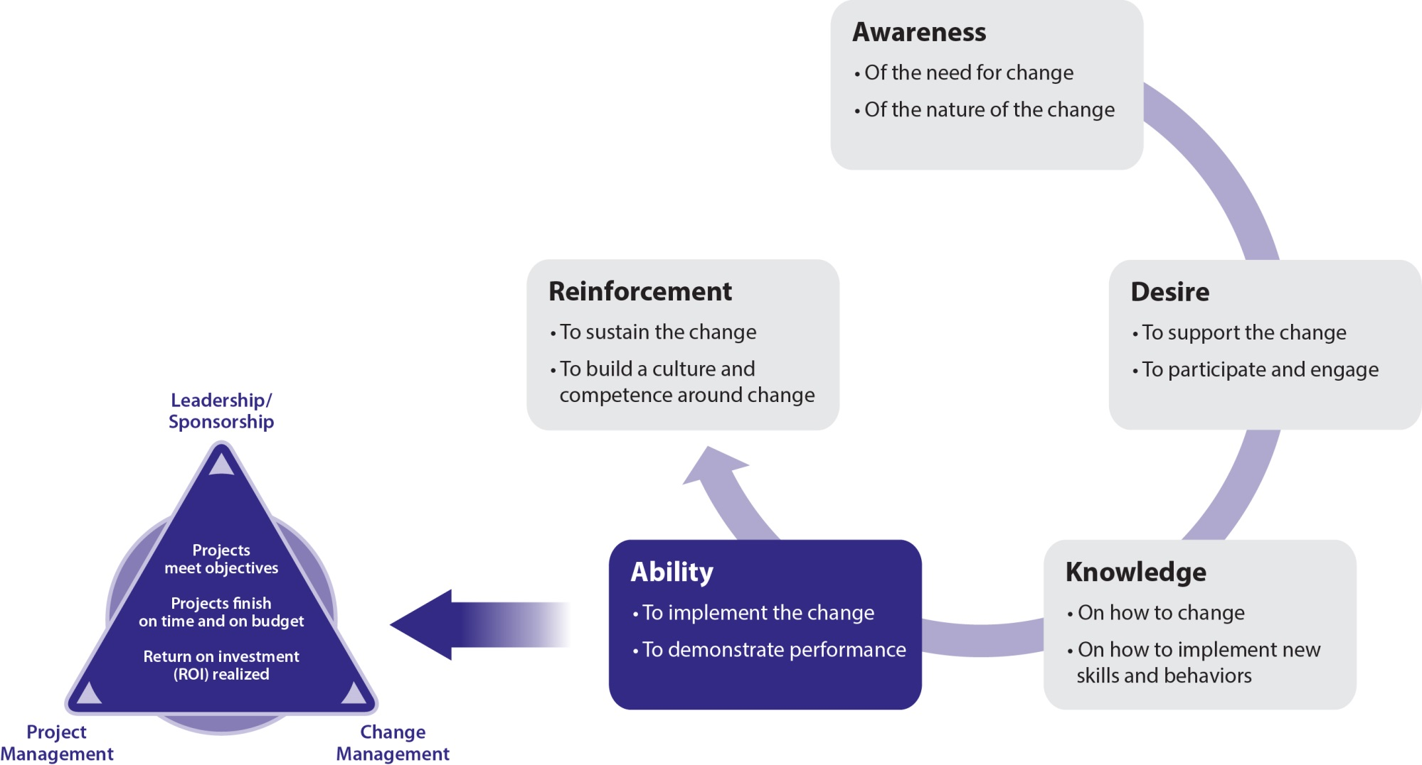
Prosci® ADKAR® Model

Slide 25
Not Everyone Changes at the Same Pace
Awareness
Desire
Knowledge
Ability
Reinforcement
Person A
Person B
Person C
Person D
Person E
Person F
Person G
Person H
Person I
Time

Slide 26
Mitigating Negative Consequences
With change, expect a decline in productivity and an increase in resistance.
1st Communication or 1st Rumor
Comfort/Security
Increasing resistance/decreasing productivity
Productivity loss
Employee dissatisfaction
Passive resistance
Worry/Uncertainty
Turnover of valued employees
Tangible customer impact
Active resistance
Opt-out of the change
Flight/Risk
Time
Prosci® Flight Risk Model

Slide 27
Resistance Management

Slide 28
Training Plan

Slide 29
Delivery
Primary Sponsor must be visible and participate
Tailor your communications
Get people excited
The key to project, keep them motivated
Engage regularly to gather feedback
People adopt change at different rates
What’s the underlying reason
Listen, understand and act
Leave it to the experts
Training is not enough on it’s own

Slide 30
Reinforcement

Slide 31
Engage
Skill Up
Coach
Analysis

Slide 32
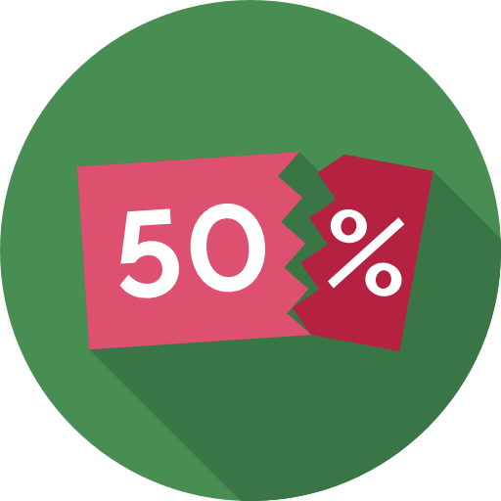
Celebrate Success

Slide 33
Reinforcement
Celebrate success
Reinforce and share good practice
Change doesn’t end with the project
Create a feedback loop

Slide 34
Change and the individual
Planning
Spend your energy planning, it makes delivery so much easier.
Delivery
When the project is delivering, change management is about support for the managers. Listen, understand and act on feedback.
Reinforcement
Encourage a culture of celebration and look for the next improvement.

