Slide 1
Delivering Cloud Ready Connectivity
Mark Vevers
Technical Design Authority
RM Education
rm.com/seminars

Slide 2
Definition: What is ‘Cloud Ready’?
Cloud Ready …..
Not like ‘HD Ready’ TVs I promise!
Different scenarios
Some services in the cloud – most local
Hybrid model – 50% split
100% cloud for Everything
rm.com/seminars

Slide 3
Services to Consider
Admin / Business:
MIS
Email
Telephony (VoIP)
Building Management
CCTV / Alarm systems remote monitoring
Device management (MDM)
rm.com/seminars

Slide 4
Services to Consider
Core Applications (inc Google G-Suite and Microsoft Office 365)
Other Apps – (e.g. RMEasimaths or Capita Reading Cloud)
Video
BYoD
Safeguarding – (filtering, logging, reporting, alerting)
Education
rm.com/seminars

Slide 5
Supporting Services
Authentication / Authorisation & Accounting
AD? AD in the cloud?
Cloud Severs & Services
Infrastructure as a Service (IaaS)
Platform as a Service (e.g. MS SQL Database)
Backup
Where is / will your data be?
rm.com/seminars

Slide 6
Part 1: MUST HAVES
rm.com/seminars

Slide 7
Part 1: What ‘Must’ your connection provide?
Bandwidth
Not just now– but three years time
Stability
Always on, always the same – no ’peak’ slow downs
Low latency / jitter
Availability
Always there
Resilience To Failure
Resilience To Denial of Service
rm.com/seminars

Slide 8
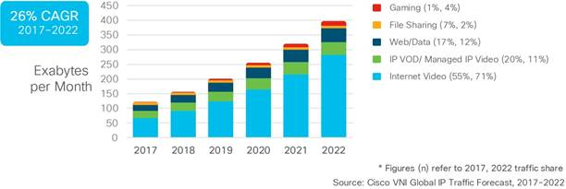
Bandwidth
We see: 30% Compound Annual Growth Rate
rm.com/seminars

Slide 9
What is ‘Congestion’ and Why Does It Matter?
Network congestion:
Packets arrive too fast at a router to fit in the outbound connection
Packets are ‘buffered’ (think Tailback)
But if too many arrive: Thrown Away!
Impact:
Audio or video ‘breaks up’
Interactive applications become unresponsive
Broken web-pages due to timeouts
rm.com/seminars

Slide 10
Stability
Depends on connection type
Contention – effective vs actual
Technology type – all different: –
Leased line
FTTP
FTTC (VDSL)
4G (LTE)
Overload may occur outside your network/circuit
5G
rm.com/seminars

Slide 11
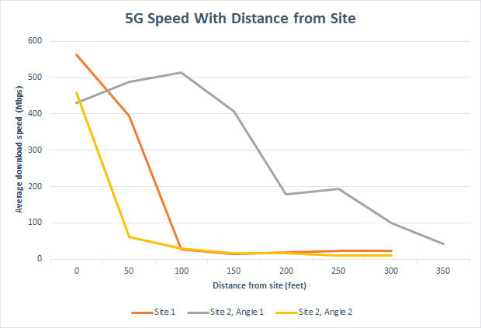
5G – to the Rescue?
Much hyped:
‘1ms Latency’
Performance
Coverage
Variability
Source: PCMag / Sascha Segan April 2019

Slide 12
Latency, Jitter & Packet Loss
Latency (or PING times):
Round trip time of a packet between two devices
Increases with
Distance
Buffering
Jitter
Variable latency – mostly due to buffering on loaded connections
Packet Loss
Connection size
Processing capacity
rm.com/seminars

Slide 13
Availability & Connection Failure
Link Down / Overloaded
DDoS’d?
No O365 / G-Suite cloud applications
Can’t access MIS
No phone / voice service
rm.com/seminars

Slide 14
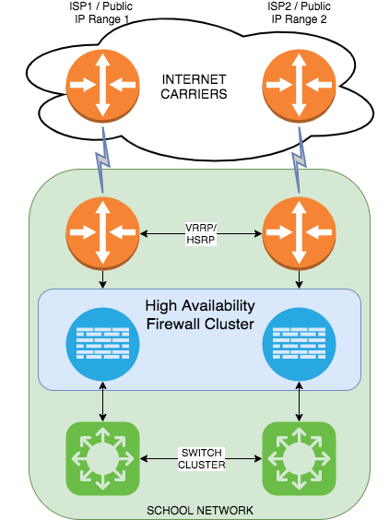
Availability Options – 1 : Full resilience
Idealised 100% Resilience
Routers
Fibre Paths
Carriers & ISPs
Different exchange/plant & equipment
Costly
Financially
Technically
Operationally
rm.com/seminars

Slide 15
Availability Options : 2 Backup FTTC circuit
Leased Line backed up by FTTC to same ISP
- Advantages
Much cheaper
Different access layer technology & plant
IP addressing, firewalling, access remain identical
=> Low financial, technical & operational overhead
Disadvantages
Bandwidth
Single points of failure
=> Balance of risk vs Benefit
rm.com/seminars
Notes:
So perhaps a more realistic option which will meet the requirements of most
Backup circuit using a different technology to the same ISP
This allows you to move the ‘problem’ of resilience to your provider
But keep costs much more under control.
But with something like FTTC – bandwidth may not be

Slide 16
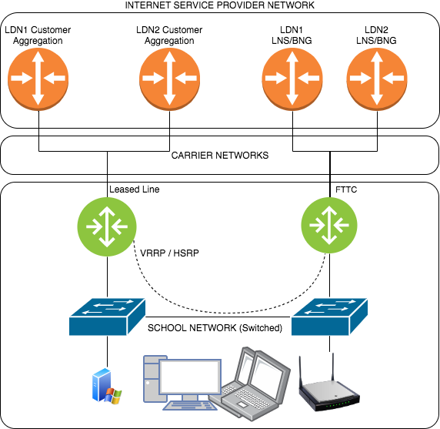
Availability Options : 2 Backup FTTC circuit
Multiple
Connections
Routers
Switches
ISP Data Centres
Carriers ?
rm.com/seminars

Slide 17
DDoS – Distributed Denial of Service
More than one type of attack
Volumetric attack
Resource consumption attack
Increasingly common
Attacks mostly DURING term time!
On-line ’booter’ services – often 5 mins for free
Short but repeated & frequent
Can be > 800Gbit/s but usually at least 10 Gbit/s
Specialist ‘tools’ / Services
rm.com/seminars

Slide 18
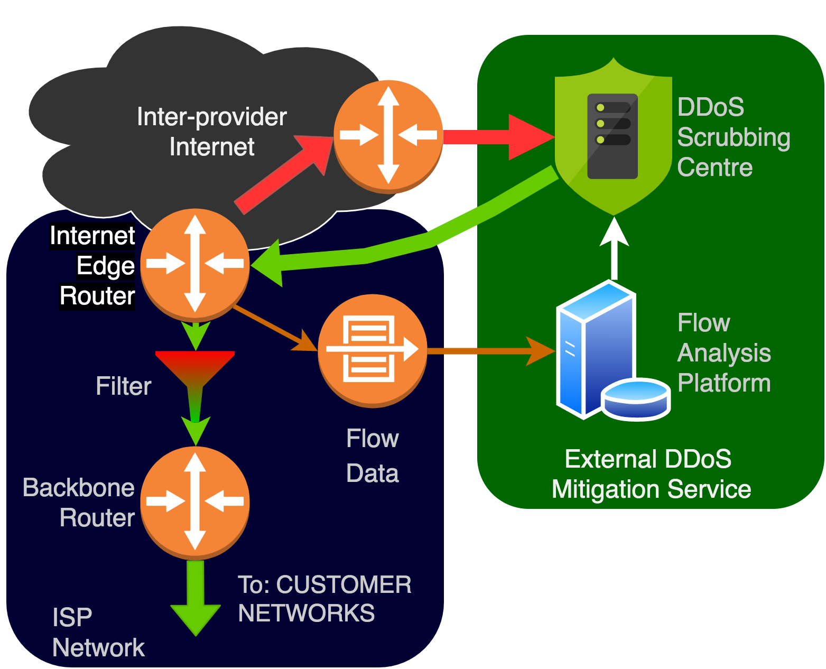
How does DDoS Defence Work?
rm.com/seminars

Slide 19
Part 1: Summary & Recommendations
Plan ahead at least three years for bandwidth utilisation
Avoided overloaded connections
But if using VoIP apply QoS to deal with ‘bursts’ anyway
Consider backup connections
Work out what you need to ‘survive’
Consider cost-benefit in detail
Connection technology IS important
5G Unlikely to be your saviour!
Usually 'cheapest'
rm.com/seminars

Slide 20
Part 2: GREAT to HAVE
rm.com/seminars

Slide 21
What ‘Could’ your connection provide?
Voice Services
Security
Intersite Connectivity
VPNs:
rm.com/seminars

Slide 22
Voice Services
PSTN/ISDN Switch Off begins NEXT YEAR!
Voice over IP
Migration to VoIP / SIP
Try to avoid ‘local’ VoIP servers
But consider emergency call out
USE QoS
rm.com/seminars

Slide 23
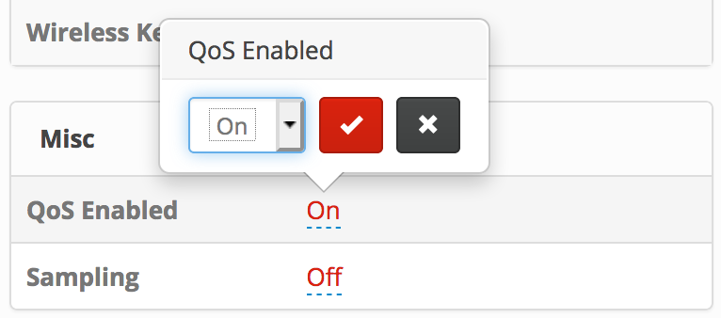
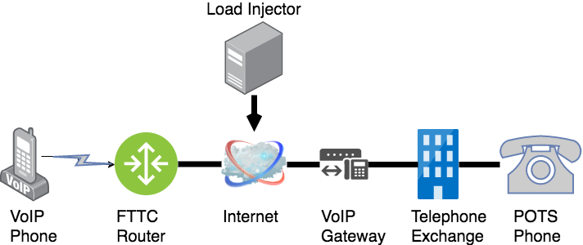
Quality of Service – Demonstration
rm.com/seminars

Slide 24
What is QoS & How does it work?
IPv4 Packet Structure:
0-3
Version
Hdr
Length
DSCP
ECN
Total Length
4-7
Identification
Flags
Fragment Offset
8-11
Time to Live
Protocol
Header Checksum
12-15
Source IP address
16-19
Destination IP address
20 …
Options
Payload (Data – ICMP / UDP / TCP packet)
rm.com/seminars

Slide 25
What is QoS & How does it work?
DSCP
Differentiated Services Code Point
Replacement for ”Class of Service” (CoS)
6 bit field (64 values) used to mark packets
Used to determine which packet queue to place a packet in:
Network Control
Routing Protocols (e.g. BGP)
Expediting Forwarding (46)
Voice & Video Realtime Data
Assured Forwarding:
Low Drop AF31(26)
Medium / High Drop AF32 (28)
Voice & Video Control / setup
Assured Forwarding:
Low Drop AF21 (18)
Medium Drop AF22 (20)
Priority Applications
Best Effort (0)
Web Browsing / YouTube
Less than Best Effort CS1 (8)
Low priority – e.g. backup traffic
rm.com/seminars

Slide 26
What is QoS & How does it work?
Packet Queues
Assigned different ‘bandwidths’
Some fixed (can’t exceed)
Some flexible – (can exceed if spare available)
Network Control
Get first ‘dibs’
But have maximum set
High Priority (EF)
Network Interface with Known Bandwidth Limit
Assured Forewarding
Lower priority
But allowed to ‘burst’
Best Effort
rm.com/seminars

Slide 27
Security - Firewalls
Local | Cloud
Full feature set | High Availability
Speed of Management | Ruleset simplification
 | Monitoring & Upgrades are Somebody Else’s Problem
Local | Cloud
Hardware maintenance & replacement costs | Limited Feature-set
Complexity of rule sets | Reliance on someone else
True High Availability (HA) is hard
rm.com/seminars

Slide 28
Inter-site Connectivity
School Clusters
Single Administrative Domain
LA Level, MAT & Shared IT Groups
Needs to connect:
Telcos
Technology Types
Options to think about:
Any-to-Any
Node & Spoke
Encryption
rm.com/seminars

Slide 29
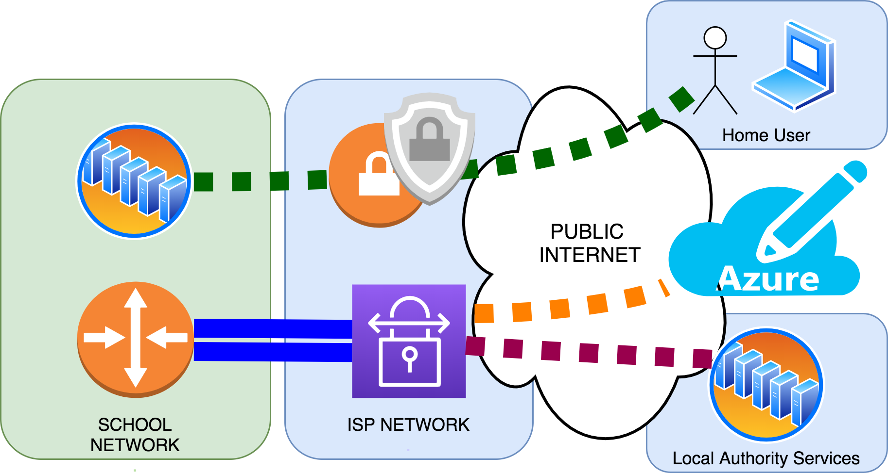
Virtual Private Networks
rm.com/seminars

Slide 30
Part 2: Summary & Recommendations
Voice Needs QoS!
Firewalls – Balance of flexibility & management
Flexible Inter-site Connections
VPNs to enable cloud migration
rm.com/seminars

Slide 31
Questions
rm.com/seminars

