Slide 1
Office 365 the Power Platform – from IT Pro to Cloud Pro
Steve Forbes
Senior Product Manager
RM Education
rm.com/seminars

Slide 2
About me
Principle Product Manager for Cyber Security and Online Safety
Certified Microsoft 365 essentials
Certified Microsoft Digital Transformation Specialist
NCSC i100

Slide 3
Stay in touch: Twitter: @edtechforbes LinkedIn: Steve Forbes Blog: www.edtechforbes.co.uk

Slide 4
Agenda
What is the Power Platform?
Cognitive Services
Bots
Microsoft Flow
Microsoft PowerApps
Real applications

Slide 5
What is the Power Platform?

Slide 6
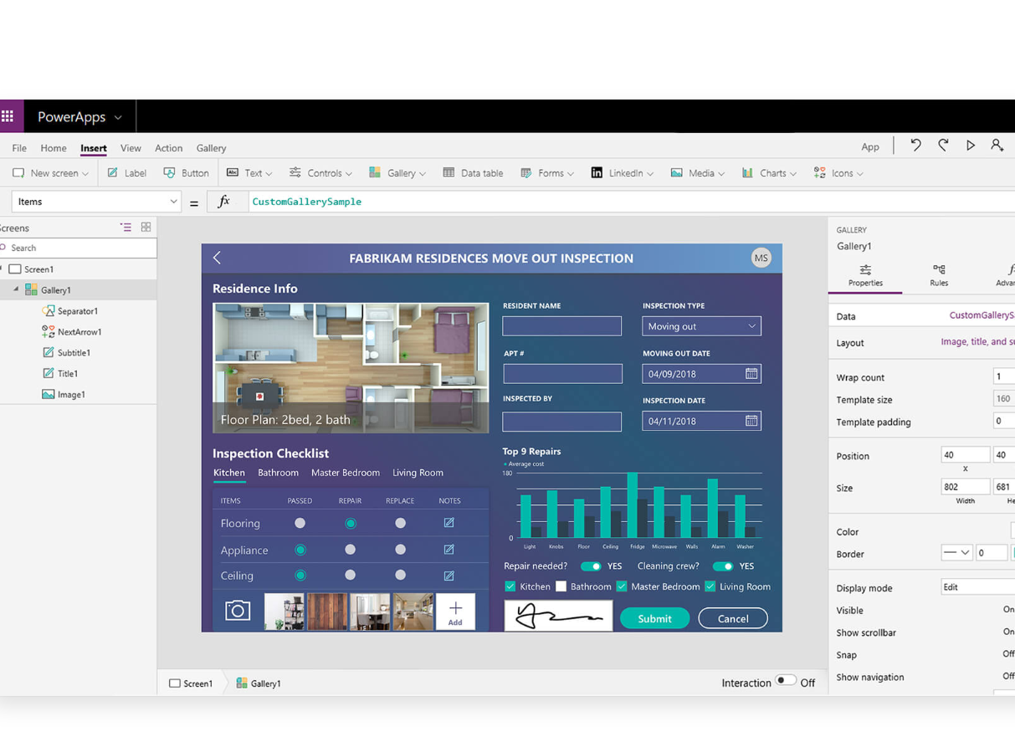
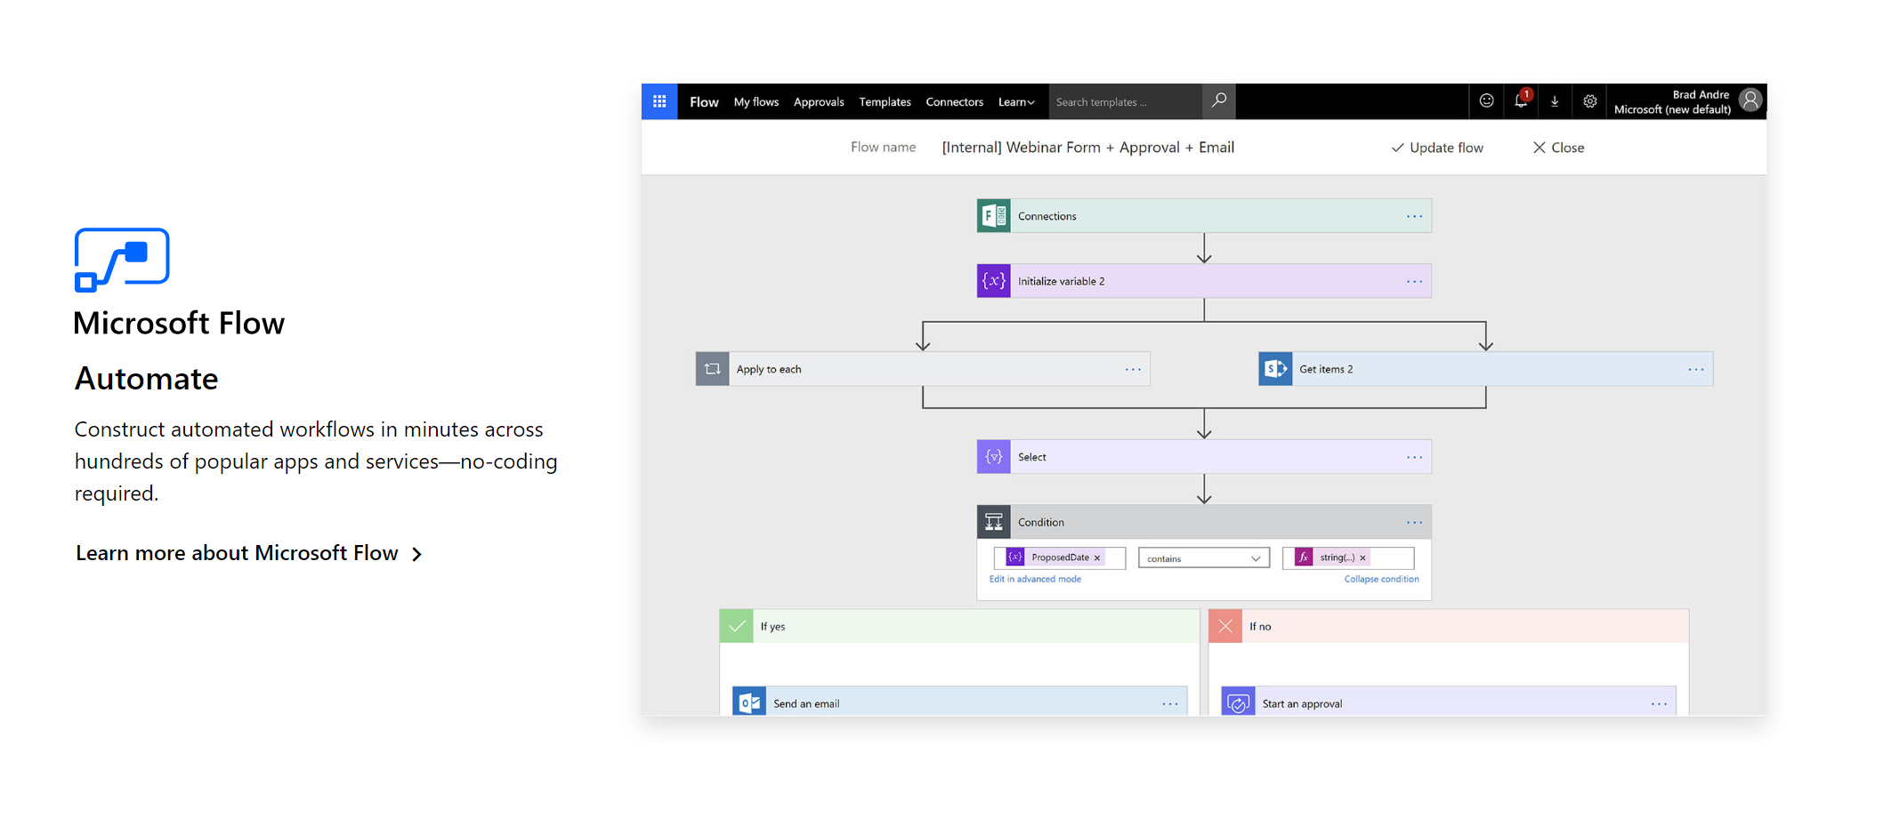
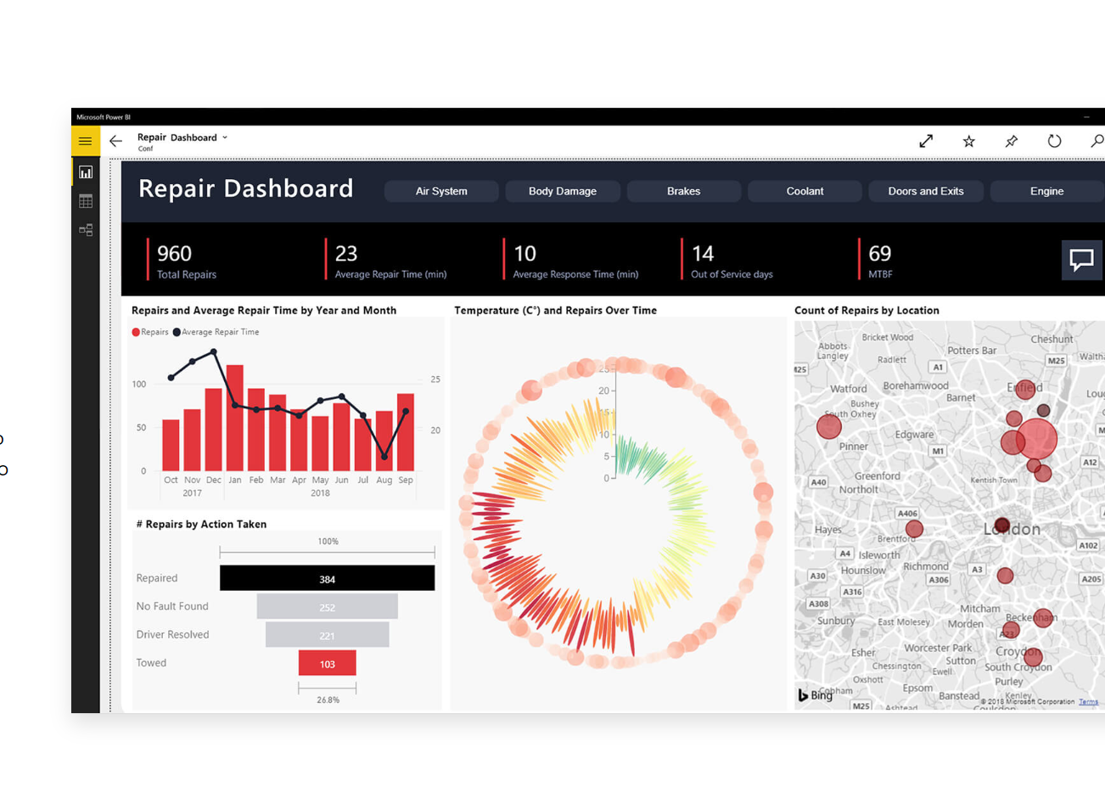
Power Platform

Slide 7
Why use the power platform?
Application rationalisation
Digital Transformation of process
Increasing productivity
Making our user’s life easier!
Most of it is free…..

Slide 8
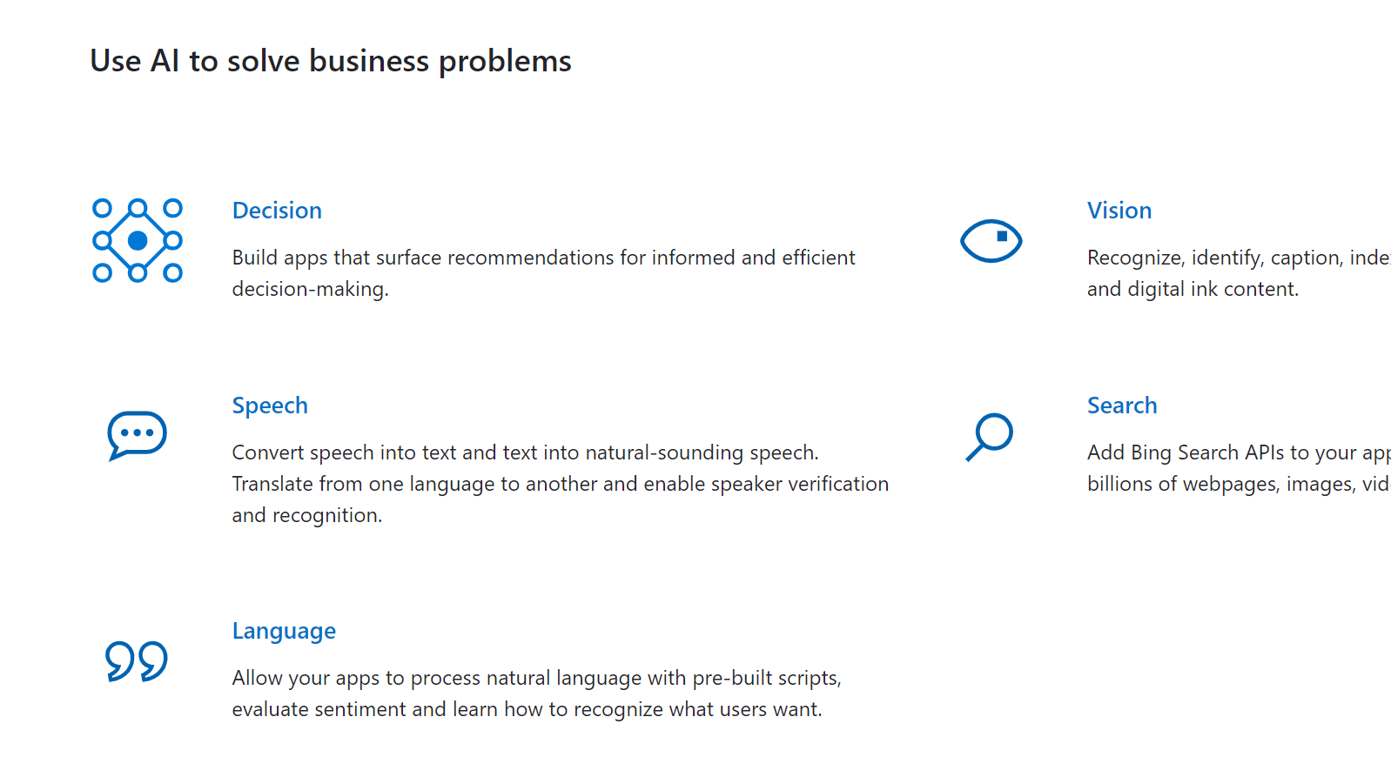
More powerful with cognitive services

Slide 9
QnA Maker, Bots and Cognitive Services

Slide 10
What is QnA Maker?

Slide 11
QnA Maker
One basic requirement with Bot Services is to seed with Question and Answers
Question & answers in many cases exist as FAQ documents, web page etc
QnA Maker is a free service
Easy to use API web service
Trains AI to respond to user’s questions in a more natural and conversational way.

Slide 12
Demo Create a QnA knowledge base and a bot
Notes:
Creating a Knowledge Base
Types of files
URLs
Chit chat
Create the Bot.
What can I do with that Bot? – Sharepoint/Web page / Teams?
Explain that this includes some cognitive services e.g. LUIS for natural language understanding
Other cognitive services – text and image recognition for images/docs in sharepoint
Content moderator

Slide 13
Microsoft Flow
Notes:
Create a list in sharepoint
Create a Flow from that list
Show Twitter connection
Show cognitive services- text recognition from Twitter into sharepoint list
Save files to Onedrive
Build in QnA Bot e.g. the Yammer QnA bot
Forms to sharepoint and email.

Slide 14
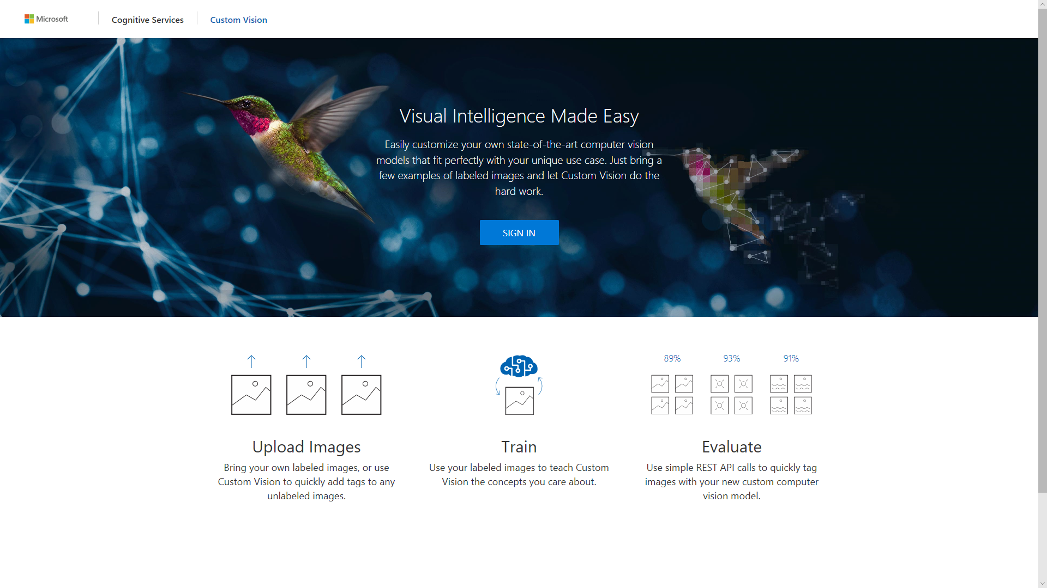
Notes:
Microsoft Flow allows users to set up no-code automated workflows between apps and services to synchronize files, get notifications, collect data, and much more.
In this demo, you will learn how to extract rich information from images automatically, using Microsoft Flow and Azure Cognitive Services. Specifically, you will:
Identify and show a simple use case for automated image analysis and classification, then discuss extensions to more elaborate use cases.
Become familiar with key Flow features, including virtual buttons, flow triggers, loops, conditional logic, and more.
Build a flow without code in under 10 minutes to confirm the presence and probability of a specific tag, and confirm that it works in the Flow mobile app.
Create a list in sharepoint
Create a Flow from that list
Show Twitter connection
Show cognitive services- text recognition from Twitter into sharepoint list
Save files to Onedrive
Build in QnA Bot e.g. the Yammer QnA bot
Forms to sharepoint and email.

Slide 15
Microsoft PowerApps
Notes:
How to create an app
Difference between a canvas app
Templates
Demonstrate how easy it is to get going and use the sharepoint list to demo how to create a simple app from the sharepoint list

Slide 16
Microsoft PowerApps is a service for creating and using custom business apps across platforms
Connect to data & systems you’re already using; create the data you need
Create apps, forms, and workflows without writing code
Use apps on web and mobile

Slide 17
Connect to the systems you’re already using
Quickly generate and customize apps based on Excel files, SharePoint Online lists, Salesforce records and more. You can even connect custom APIs.
Even connecting to data in your on premise systems through a common Data Gateway.
Your apps will be able to fully interact with underlying sources and will respect the permissions you’ve already established in them.

Slide 18
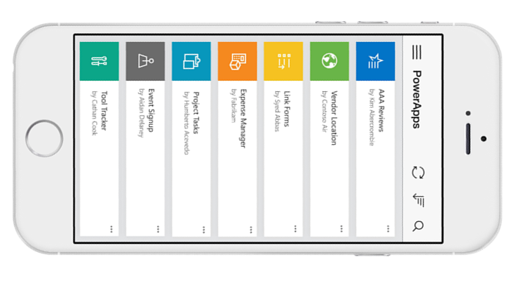
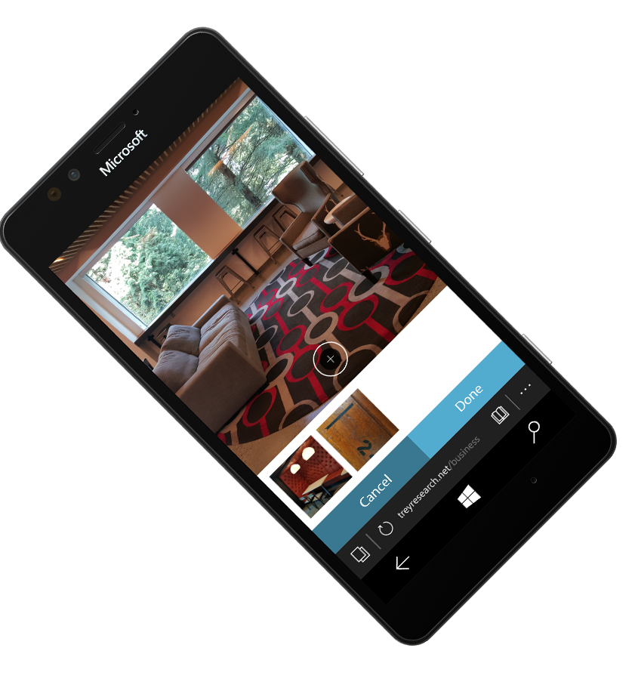
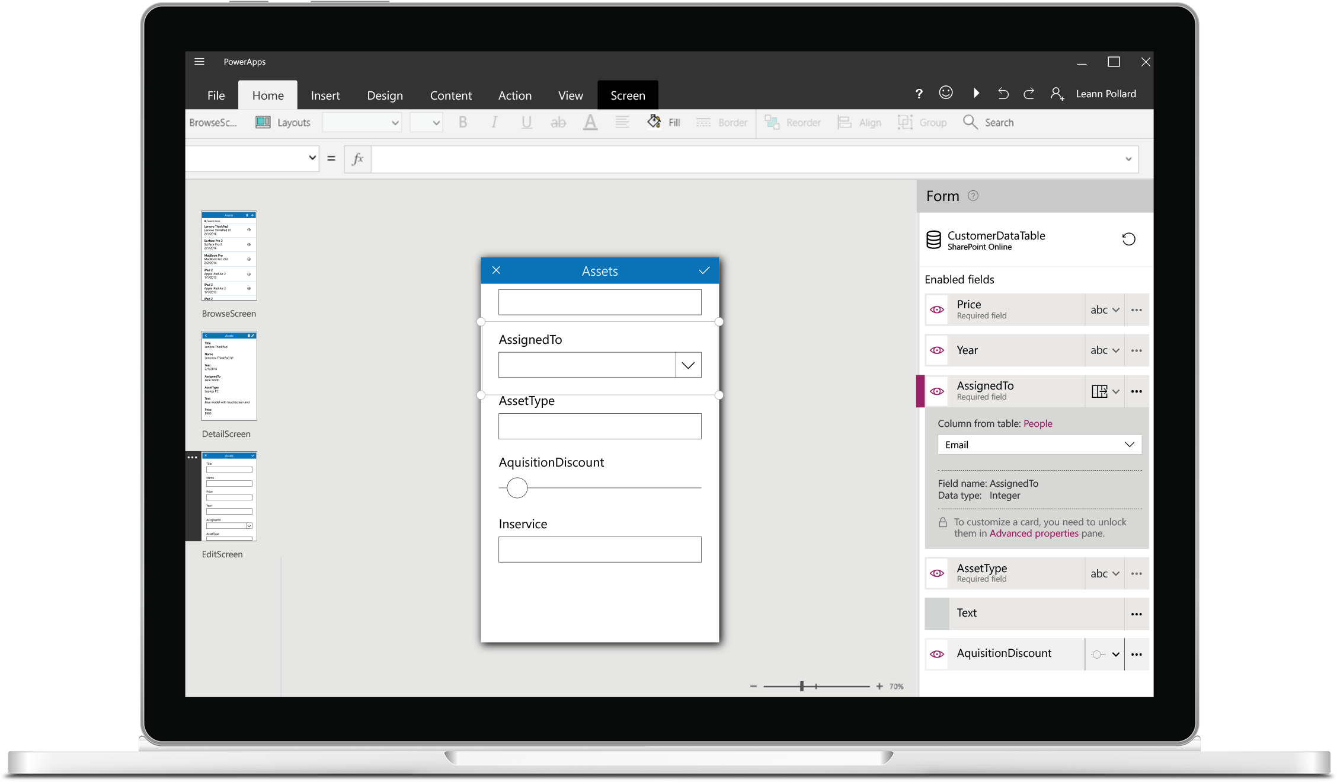
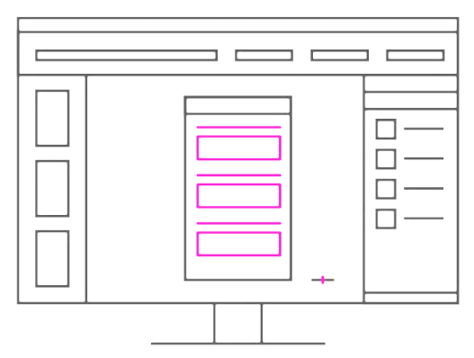
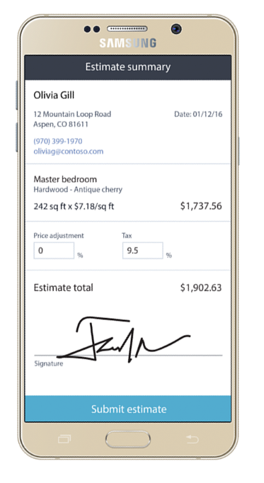
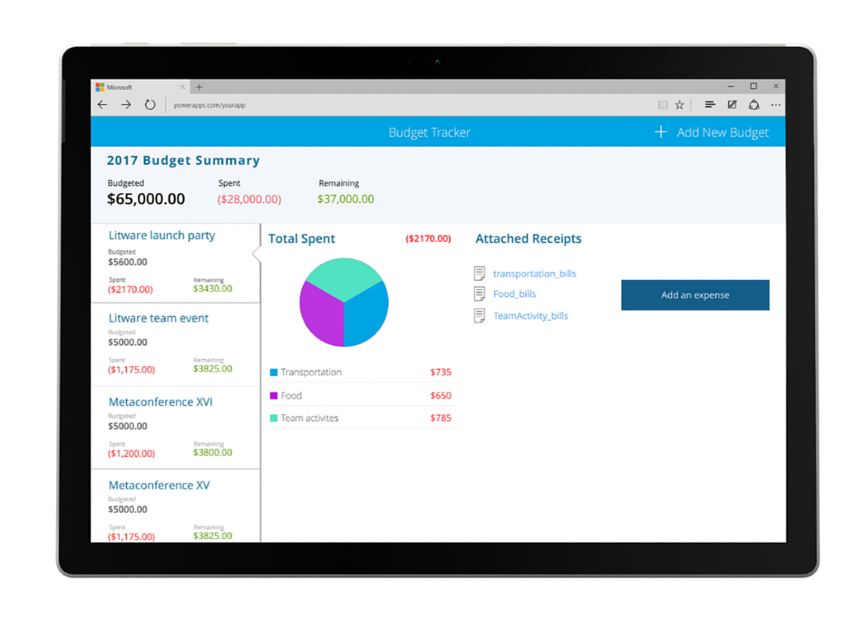
Build useful apps without writing code
Craft forms and screens in a visual designer that helps you see exactly what you’ll get
web.powerapps.com
Build business logic into your apps with
an Excel-inspired expression language
Take advantage
of device capabilities like cameras, GPS, and digital ink
Extend the capabilities of connected data sources, or focus just on the bits you need

Slide 19
Publish apps instantly for web and mobile
Get apps to your team when and where they’re needed, whether that’s on the web, iOS or Android—no app store required.
web.powerapps.com

Slide 20
Real applications

Slide 21
Teacher IT PowerApp
Notes:
Connecting the QnA maker
Sharepoint list for requests
Leave request
School visit request

Slide 22
Other Potential Power Platform usage
- Bot on website QnA for parents
Leave request
Appraisal system
Room/equipment booking
Security escalations
School trip request
Notes:
Form embedded for parent in website – triggers flow and alert on powerapp? Or start a planner and post in Teams

