Slide 1
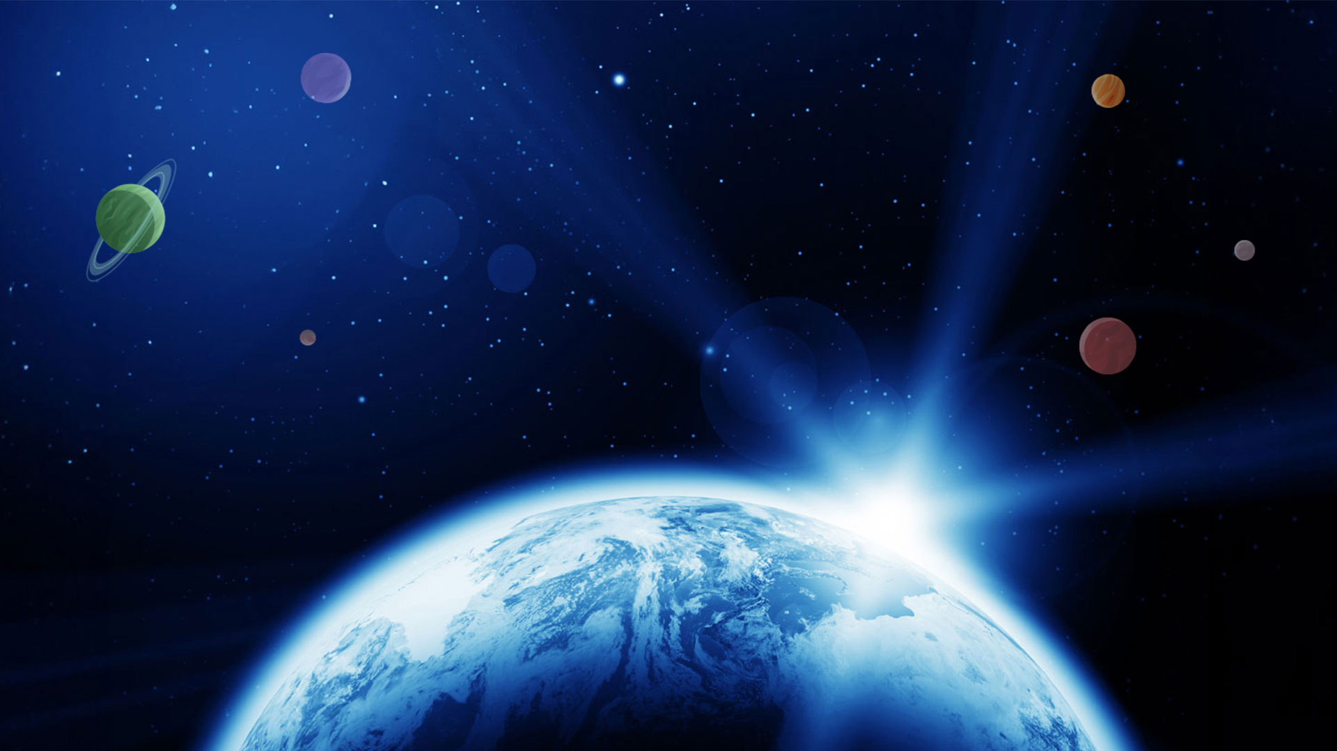


Partnership​
Resource Plan​

Slide 2
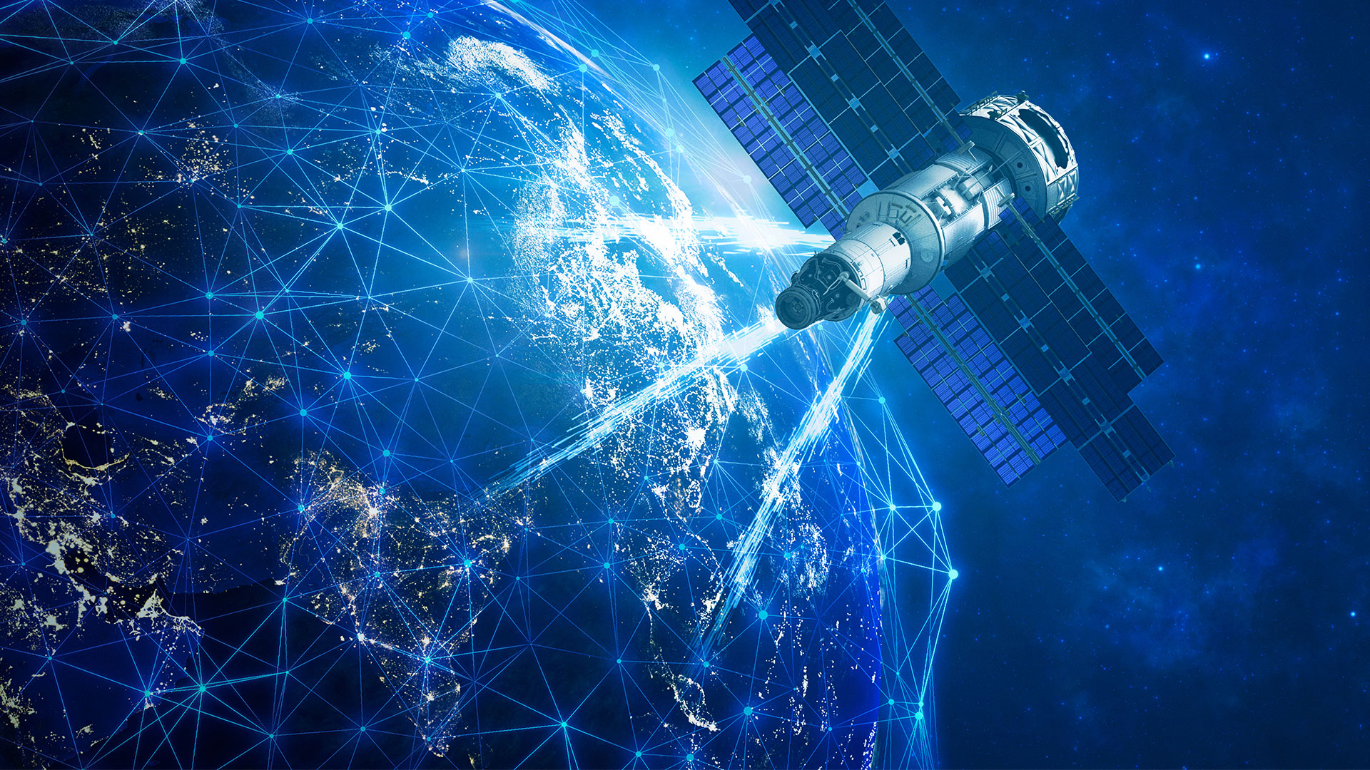
Lesson 2
Exploring
Satellites

Slide 3


Lesson 2: Exploring Satellites
 | Pre work​ | Mike Mongo Lessons ​ | Post Session Lessons​ | STEAM Resources​
Activities | What is a satellite? (Natural vs Man-made Satellites). Knowledge sharing about Satellites and how they help us. How do satellites help us? | What do Satellites do and how do they help us?​ | Activity: Junk Modelling a Satellite. What is the Satellites mission? What is it going to help us do? How is it going to do that? What sensors will it need? How will it get to space?

Slide 4
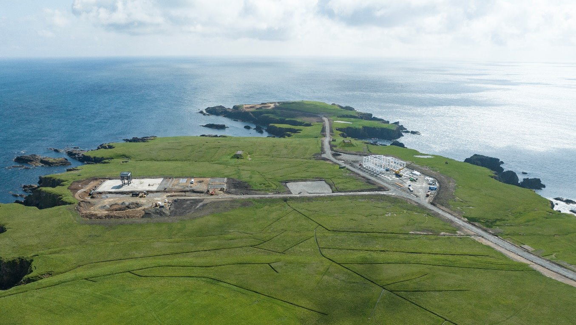


Session 2 – Exploring Satellites​
SaxaVord Spaceport is a facility in Shetland which will be able to host Satellite Launches.
Do you know what a satellite is? What do they do for us?
Notes:
Satellites orbit the earth.
Satellites give us information about the earth.
There are lots of things that we wouldn’t be able to do if it weren’t for satellites. Can your students name any?
Discuss the difference between man made satellites and natural satellites.
The Moon is a natural satellite as it orbits Earth and Earth is a satellite as it orbits the Sun.

Slide 5
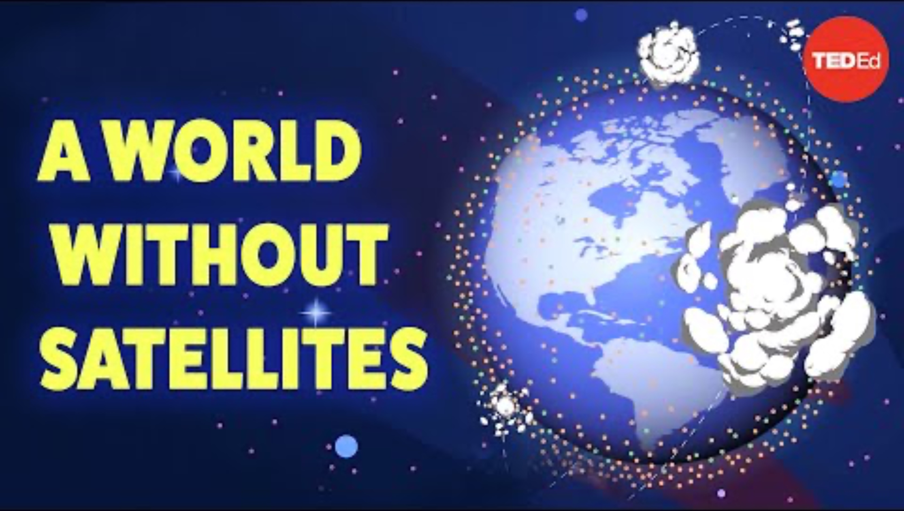
Session 2 – Exploring Satellites​
What would happen if we didn’t have Satellites?

Slide 6

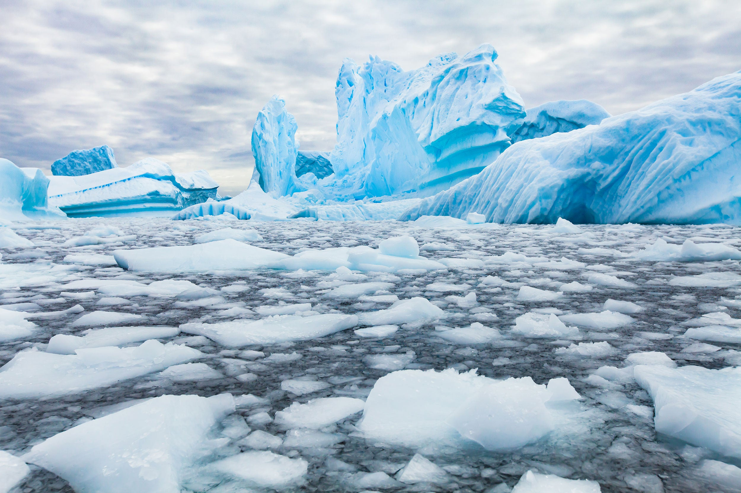
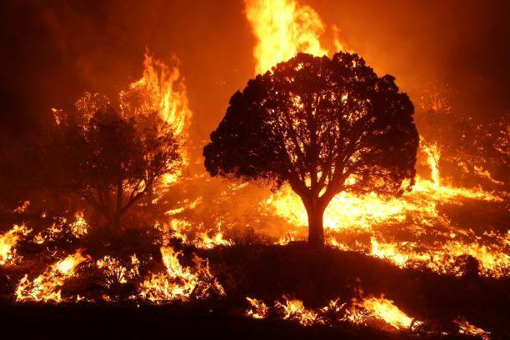
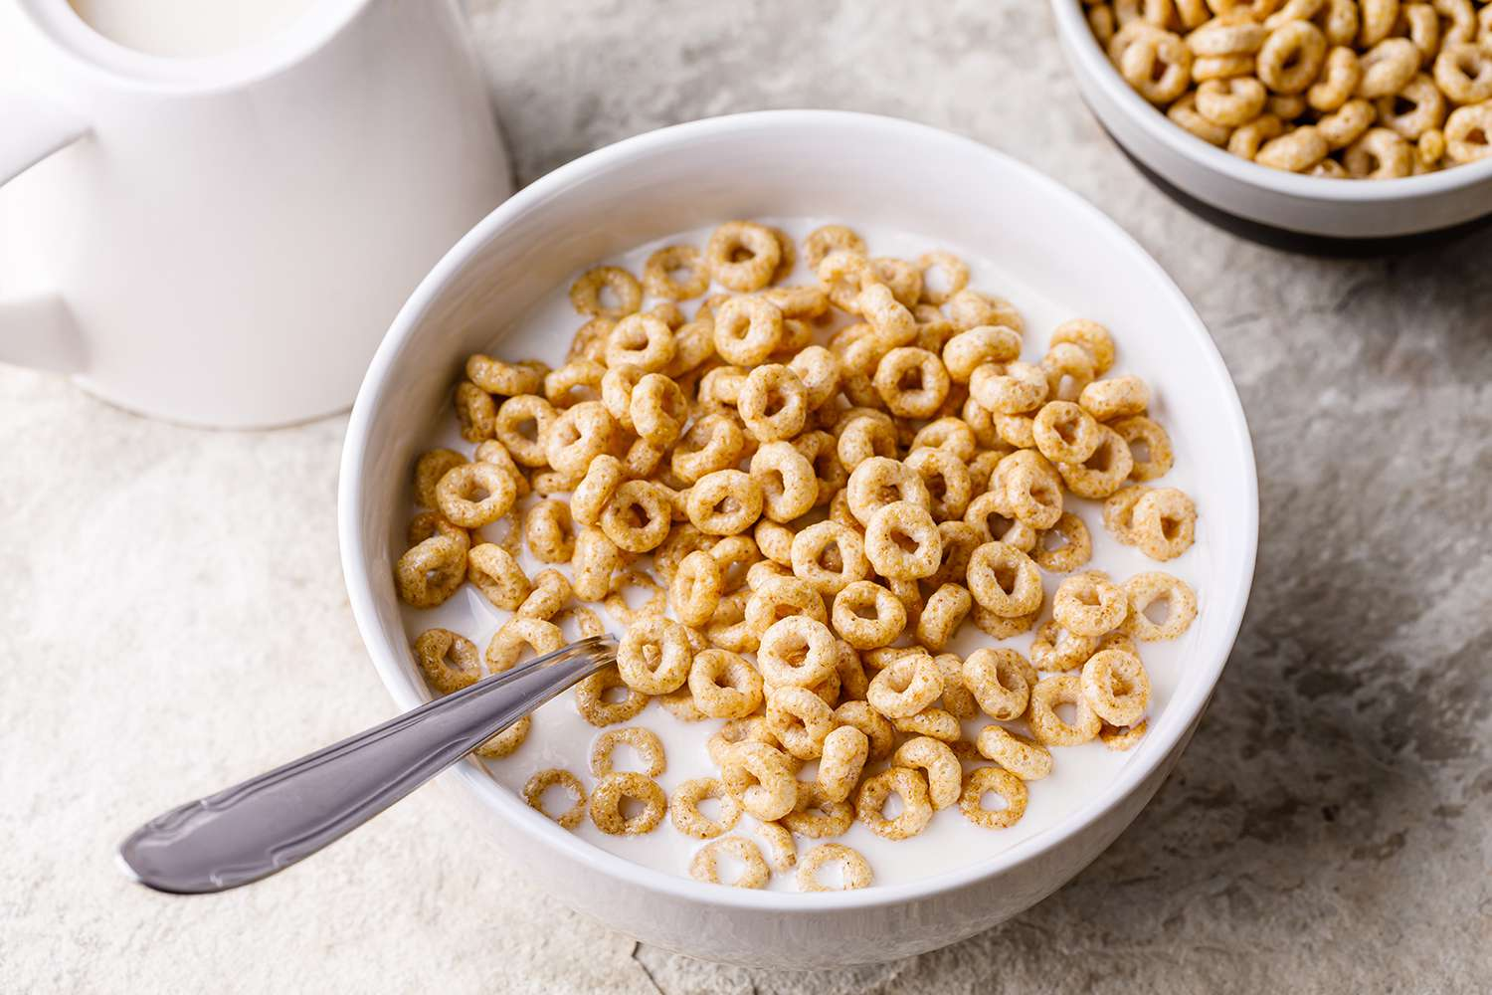
Session 2 – Exploring Satellites​
Can you explain how each of these images are linked to Satellites?
Notes:
1. Ice Caps Melting
In 2010, ESA launched its first mission dedicated to the study of ice.
During its 12 years in polar orbit, CryoSat – which is part of ESA’s Earth Explorer programme – has continued to deliver detailed insight into Earth’s frozen zones.
The satellite’s altimeter returns readings of ice height by timing how long it takes for radar waves to bounce back to the satellite from the ice surface. For ice floating in the polar oceans, ice thickness is inferred by measuring the height of the ice above the water.
2. Wildfires
Satellites can help monitor wildfires in several ways, including before, during, and after an event:
Before the fire: Satellite images can help identify areas that are at risk of fire hazards.
During the fire: Satellites can help determine the fire's direction, intensity, size, and burning area, which can help inform targeted responses. For example, some satellites have thermal infrared cameras that can report fires larger than 33 feet within an hour of ignition.
After the fire: Satellite imagery can help detect burned vegetation and soil, identify burn scars, and monitor vegetation recovery.
3. Cereal
Satellites help farmers in many ways, including:
Crop health monitoring.
Satellite images can help farmers identify issues like nutrient deficiencies, diseases, drought, and stress early. This allows farmers to take corrective action and reduce crop losses.
Irrigation management
Sensors in the field can show which areas need water, which helps farmers distribute water more effectively and reduce waste. Satellite data can also help avoid over or under irrigation, which improves the quality of agricultural products and increases yields.
Soil moisture
Satellites can measure soil moisture, which can help farmers predict and prepare for droughts, floods, and other risks.
Precision agriculture
Satellites can provide data on diseases, nutrient levels, structural anomalies, and moisture stress. This allows farmers to monitor and optimize crop health, and assess seasonal yield variations.

Slide 7
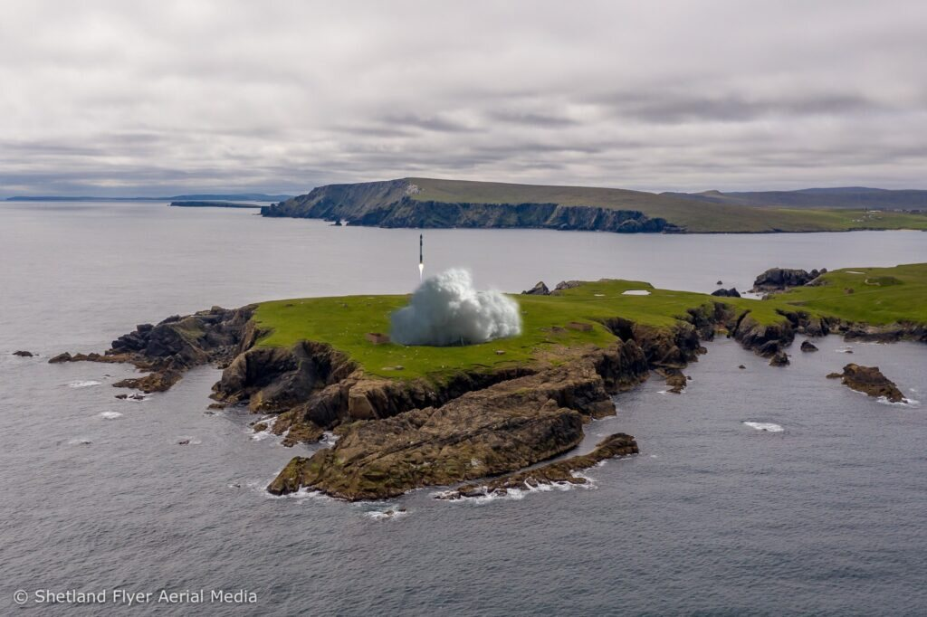
Session 2 – Exploring Satellites​
Many of the satellites launched from SaxaVord Spaceport will be for Earth Observation. What do you think this means and why is it important?
Notes:
Earth Observation = Observing Earth.
These satellites will gather information which will inform decision making on Earth to solve problems related to climate change.

Slide 8
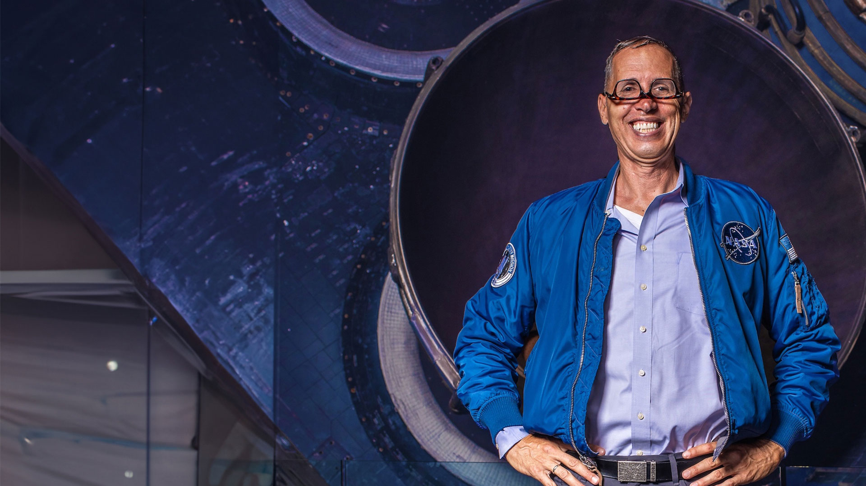
Mike Mongo
Live Lessons

Slide 9
Session 2 – Exploring Satellites​
Task:
Can you think of a problem on Earth that a satellite could help to solve? Have a think about the uses of Satellites you have heard so far.
This problem could be as small or large as you like.
In groups, can you design a satellite to help solve this problem?
Notes:
Problem examples include wildfires, rising sea levels, the ice caps melting, keeping track of your pets… the pupils can be as creative as they like.

Slide 10
