Slide 1
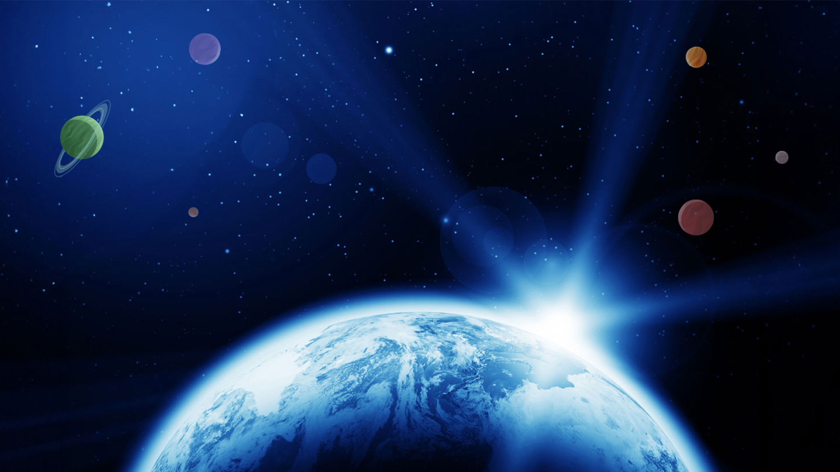


Partnership​
Resource Plan​

Slide 2
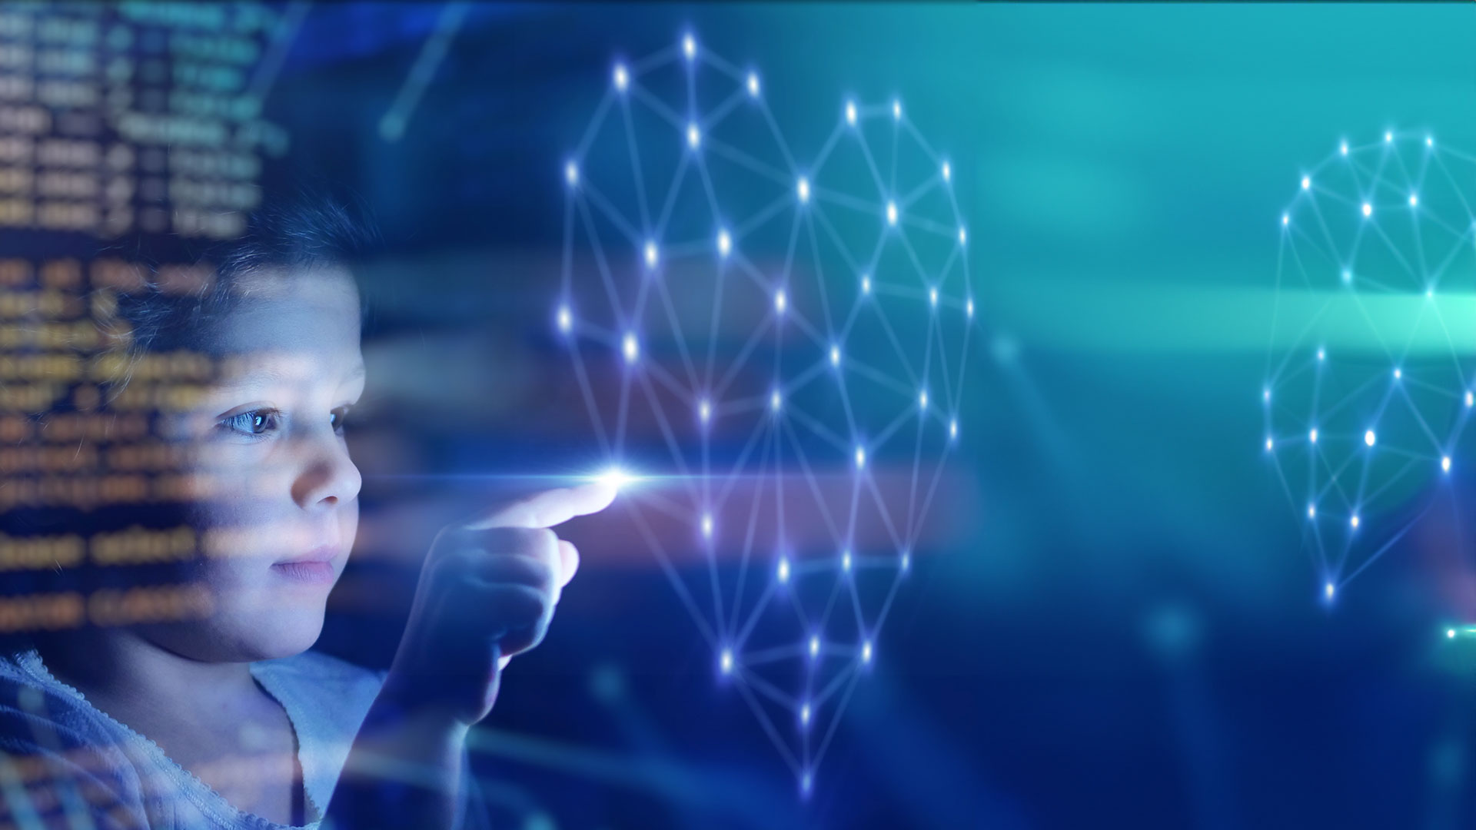
Lesson 4
AI in Space

Slide 3


Lesson 4: AI in Space
 | Pre work​ | Mike Mongo Lessons ​ | Post Session Lesson​s | STEAM Resources​
Activities | What is AI? How is AI used everyday? Video: What is AI https://youtu.be/pv9GF281Dp0?si=XmziLDHkpmiERuY8 Video KS3 How will AI change the world? TED-Ed https://youtu.be/RzkD_rTEBYs [youtu.be] | Conversations with AI- Sherlock example. Bina 48 AI in space: How are SaxaVord using AI? AI in everyday life. | How AI is used in space. Video: AI in Space https://youtu.be/EdEvgtteU54?si=Z2X6YtwBB0bLxI5T Things to try with AI in the classroom. | ESA - Artificial intelligence in space Video: How does AI work? STEM for kids. https://www.youtube.com/watch?v=fLcZRDiQyNY Video: What is Artificial Intelligence? Argo’s World. STEM for kids. https://www.youtube.com/watch?v=HdIppwUJ0f8

Slide 4



Lesson 4 Whole class activity-
What is AI?
What is intelligence?
What do we mean by Artificial Intelligence? (AI)
Notes:
Discuss and make notes as a group.
In pairs ask children to describe what is intelligence in one word or two and the same for AI. Share responses.

Slide 5
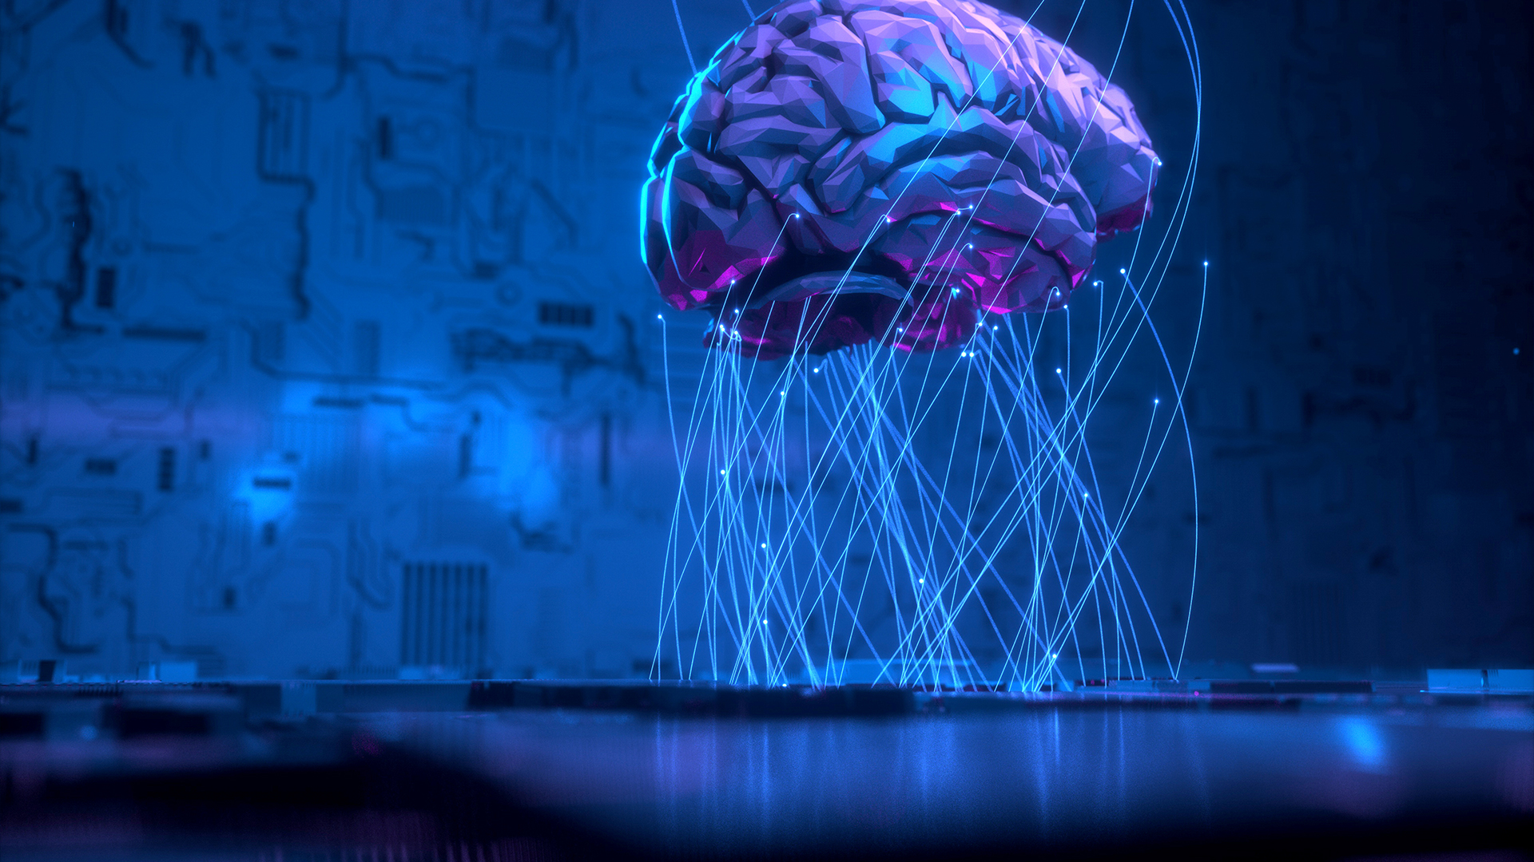
Artificial intelligence (AI) is a machine’s ability to take decisions, solve problems, and learn (like a human being)
Notes:
With AI we want machines to be intelligent like humans. Artificial intelligence (AI) is a machine’s ability to take decisions, solve problems, and learn (like a human being)

Slide 6
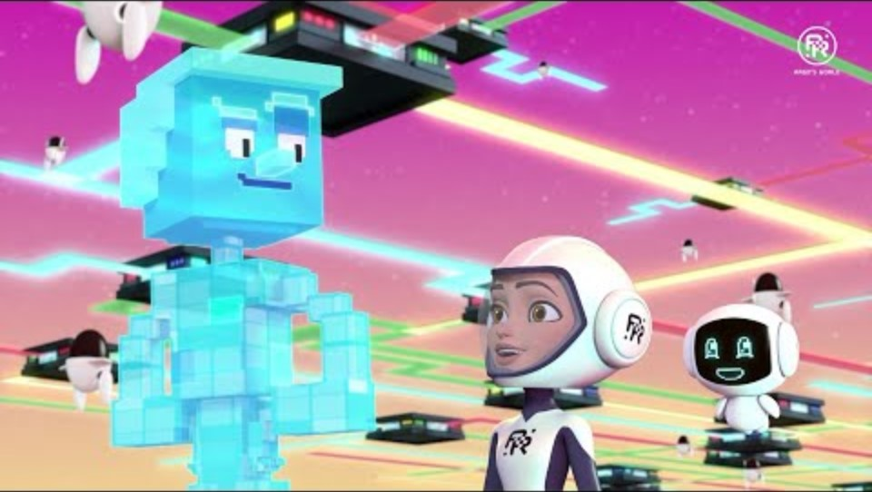
Notes:
Artificial Intelligence = Brain?? - Argo's World | STEM for Kids and Teens (Science & Tech)

Slide 7
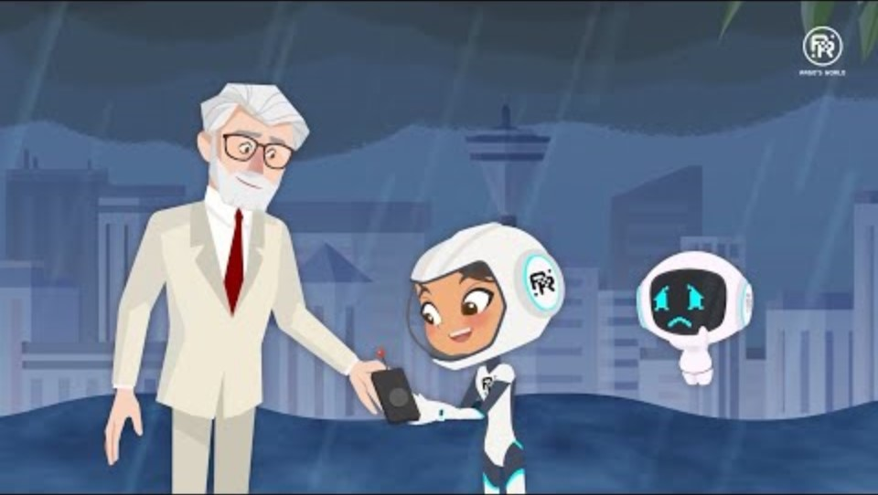
Notes:
What is AI What is ARTIFICIAL INTELLIGENCE? - Argo’s World | STEM for Kids (Science, Tech, Engineering, Math)(2020, August 21)YouTubehttps://www.youtube.com/watch?v=HdIppwUJ0f8
With AI we want machines to be intelligent like humans. Artificial intelligence (AI) is a machine’s ability to take decisions, solve problems, and learn (like a human being).
What did you notice from the video?

Slide 8
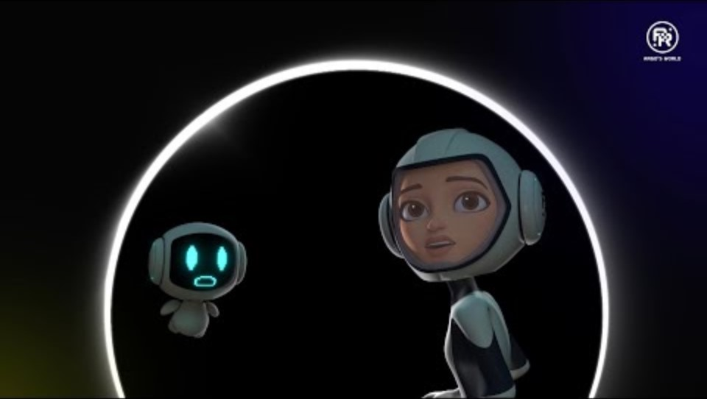
KS3- How does AI work?
Notes:
VIDEO: How does ARTIFICIAL INTELLIGENCE work? - Argo's World | STEM for Kids and Teens (Science & Tech)

Slide 9
AI and Space Travel
Notes:
Video
AI and Space Travel
https://youtu.be/EdEvgtteU54?si=Z2X6YtwBB0bLxI5T

Slide 10
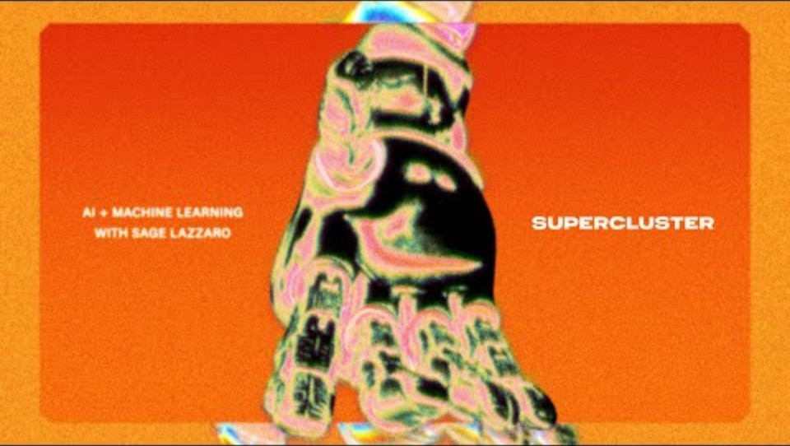
Notes:
AI and Space Travel
https://youtu.be/EdEvgtteU54?si=Z2X6YtwBB0bLxI5T

Slide 11
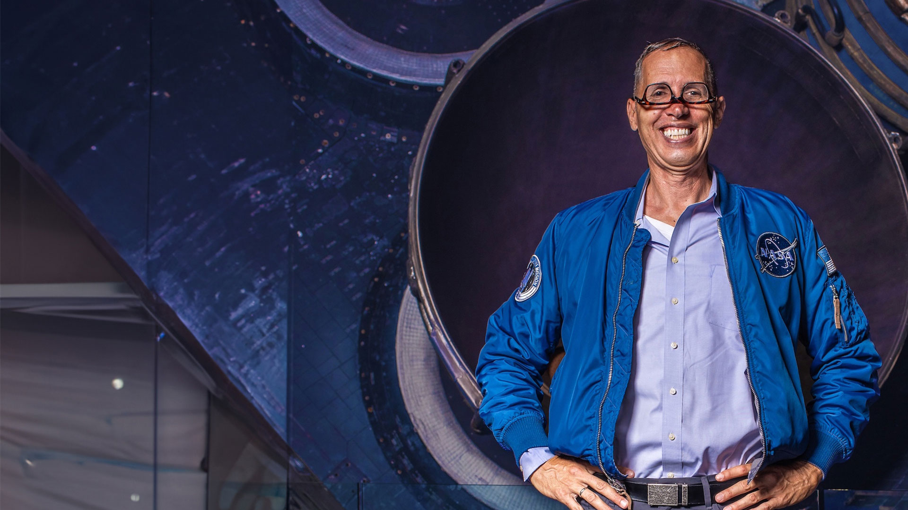
Mike Mongo
Live Lessons

Slide 12
Session 4 – AI in Space
Lesson 4 - AI in everyday life
Digital Assistants
Navigation
Recommendation systems
Can you give examples?
Notes:
With AI we want machines to be intelligent like humans. Artificial intelligence (AI) is a machine’s ability to take decisions, solve problems, and learn (like a human being).
AI can clean your room, drive a car, and even play computer games.
YouTube Video suggestions
Google Maps navigation
Digital assistants – Alexa, Siri, Google Assistant, etc.
Self-Driving Cars
AI fitness apps
AI in Music and Arts
https://youtu.be/RzkD_rTEBYs?si=NfBQa0zz71Sc106l
How will AI change the world.

Slide 13
Session 4 – AI in Space
What intelligent things can AI do?
Can you think of any more you may have come across is everyday life?
How can AI help us? How could it help us in Space?
Notes:
With AI we want machines to be intelligent like humans. Artificial intelligence (AI) is a machine’s ability to take decisions, solve problems, and learn (like a human being).
AI can clean your room, drive a car, and play computer games against us!
YouTube Video suggestions
Google Maps navigation
Digital assistants – Alexa, Siri, Google Assistant, etc.
Self-Driving Cars
AI fitness apps
AI in Music and Arts

Slide 14
Session 4 – AI in Space
Interesting AI –
AI in Music
AI Duet
https://experiments.withgoogle.com/ai/ai-duet/view/
Have a go!
Notes:
AI in Music

Slide 15
Session 4 – AI in Space
AI in Art
Go to quickdraw and have competition in class
Quick, Draw! (quickdraw.withgoogle.com)
Try Autodraw
AutoDraw
Try out different combinations of images
https://reiinakano.com/arbitrary-image-stylization-tfjs/

Slide 16
Session 4 – AI in Space
Extension Activity:
Design Your Own AI Helper
(20 minutes) KS3
In pairs or small groups:
Imagine an AI helper (like a robot or virtual assistant) that could assist them in their daily lives.
Draw and describe their AI helper. What tasks would it perform? How would it make their lives easier? How would it work?

Slide 17
Session 4 – AI in Space
Plenary: Quiz

Slide 18
